Slide 1

Package, APIs, Data Set and Models

Slide 2
Objectives
Explain the function of an API and list some common API-related terms.
Discuss the characteristics of a dataset and the ways data can be structured.
Identify some of the libraries used in data science and the types of functionalities a library can provide.
Compare and contrast between machine learning, deep learning and their use cases.
Discuss the different classes of machine learning models.
Package, APIs, Data Set and Models

Slide 3
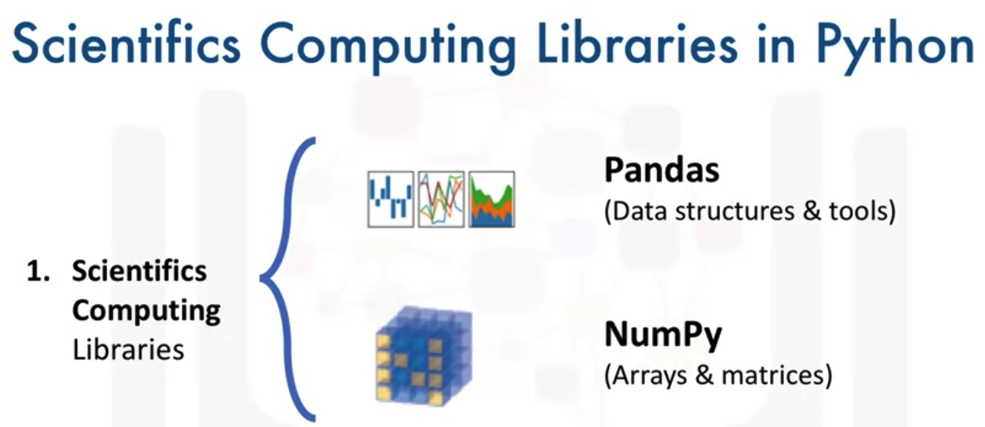
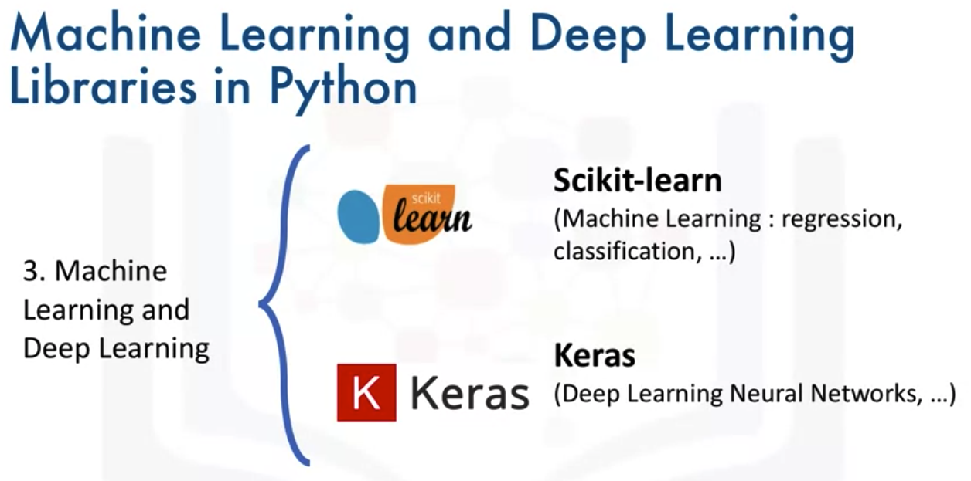
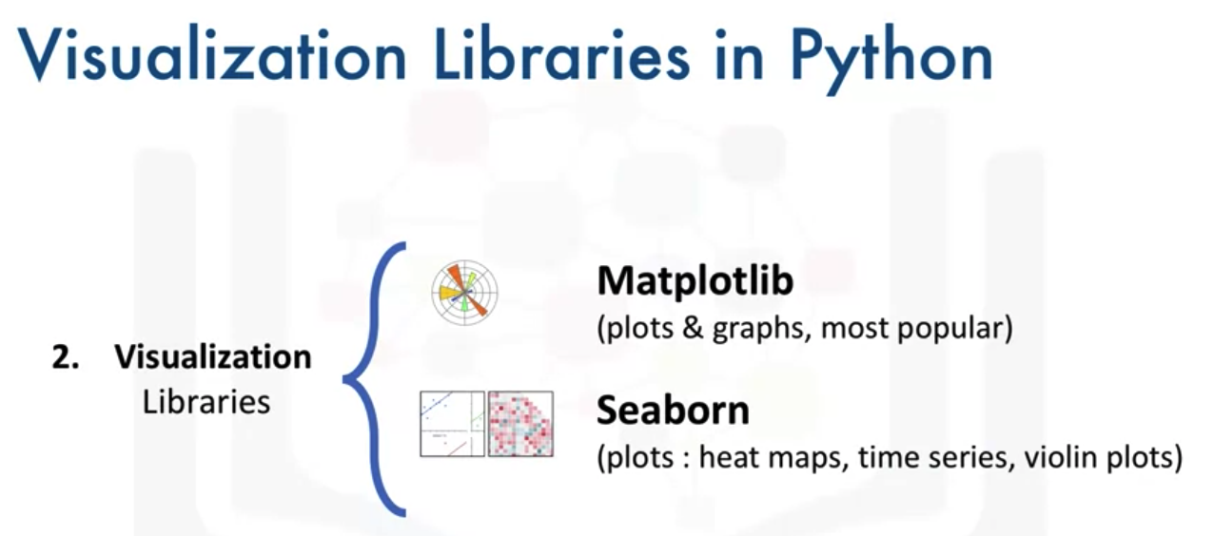
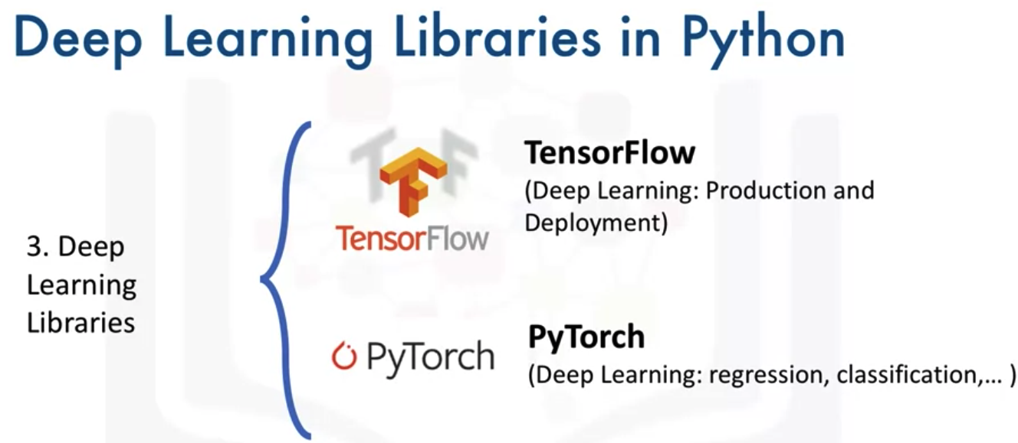
Libraries for Data Science
Package, APIs, Data Set and Models

Slide 4
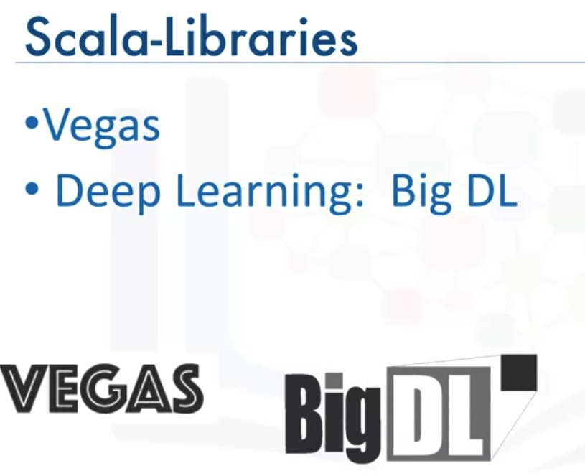
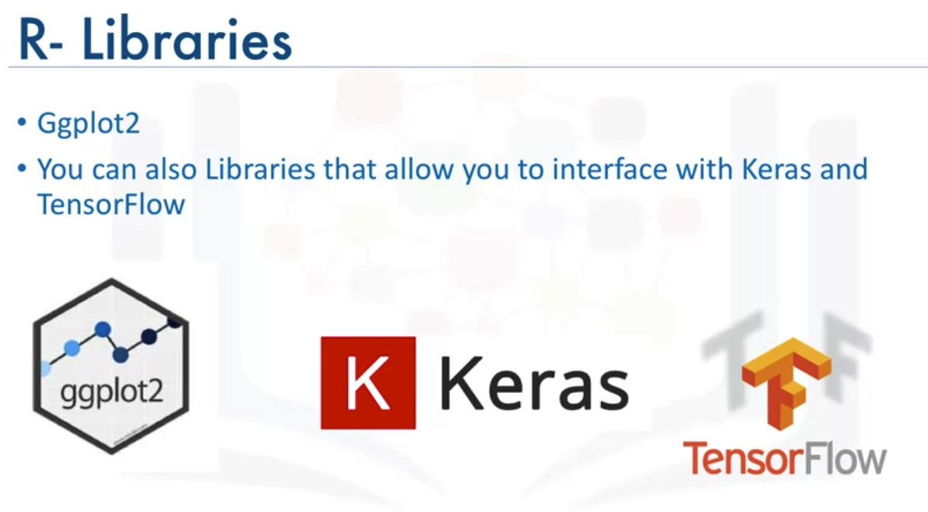
Libraries for Data Science
Package, APIs, Data Set and Models

Slide 5
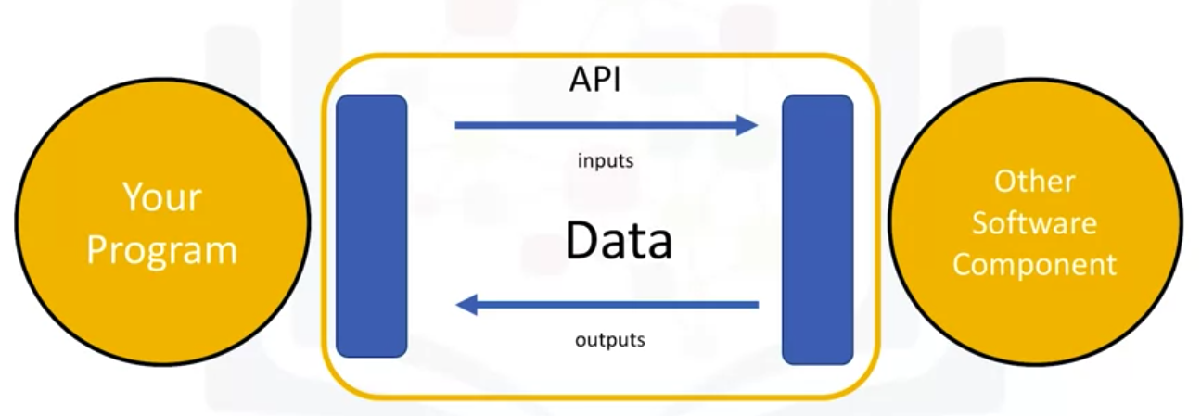
Application Programming Interface- API
What is API?
Package, APIs, Data Set and Models

Slide 6
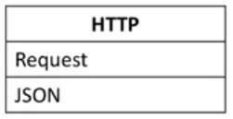
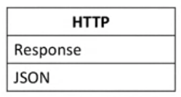
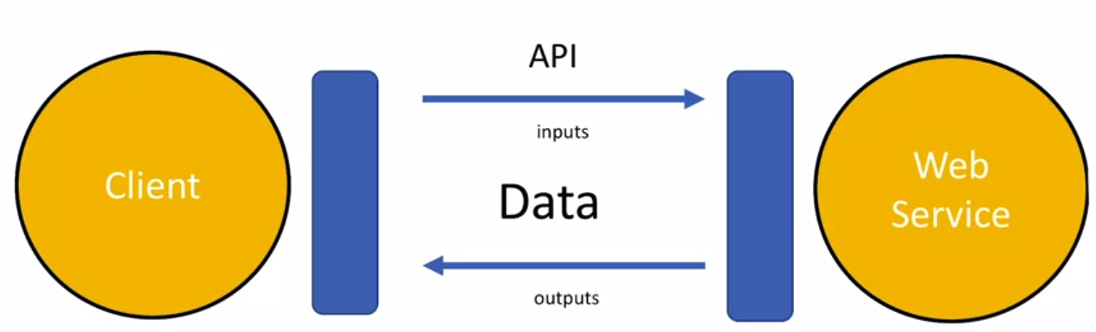
Application Programming Interface- API
REST APIs: Representational State Transfer APIs
REST APIs are used to interact with web services- application that you call through the internet
They have a set of Rules regarding:
  Communication
  Input or Request
  Output or Response
Package, APIs, Data Set and Models

Slide 7
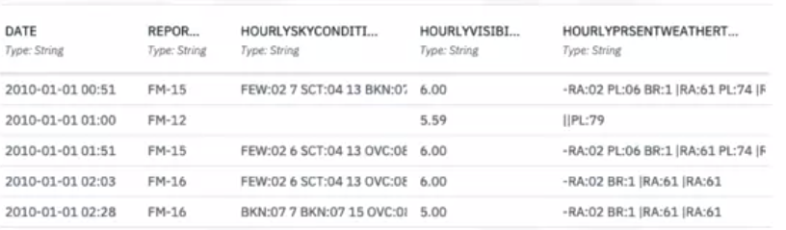
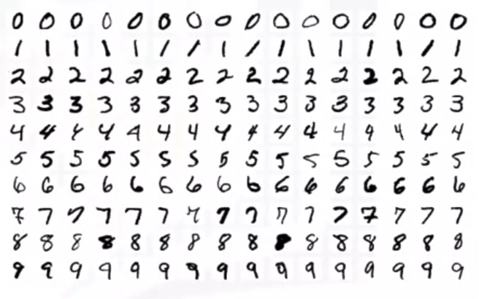
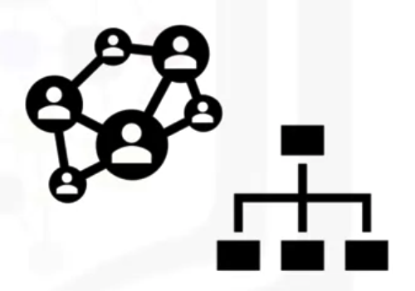
What is a data set?
Collection of data
Data Structures:
  Tabular data
  Hierarchical data, network data
  Raw files
Package, APIs, Data Set and Models

Slide 8
Data ownership
Private data
  Confidential
  Private or personal information
  Commercially sensitive
Open data
  Scientific institutions
  Governments
  Organizations
  Companies
  Publicly available
Package, APIs, Data Set and Models

Slide 9
Where to find open data
Open data portal list from around the world
  http://datacatalogs.org/
Governmental, intergovernmental or organization websites
  http://data.un.org/ ( United nations)
  http://www.data.gov (USA)
  https://www.euroopeandataportal.eu/en/ (Europe)
Kaggle
  https://www.kaggle.com/datasets
Google data set search
  https://datasetsearch.research.google.com/
Package, APIs, Data Set and Models

Slide 10
Machine Learning Models
What is a models? Give your opinions!
Data can contain a wealth of information
Machine learning models identify patterns in data
A model must be trained on data before it can be used to make predictions
Supervised, unsupervised and reinforcement learning are types of machine learning
Package, APIs, Data Set and Models

Slide 11
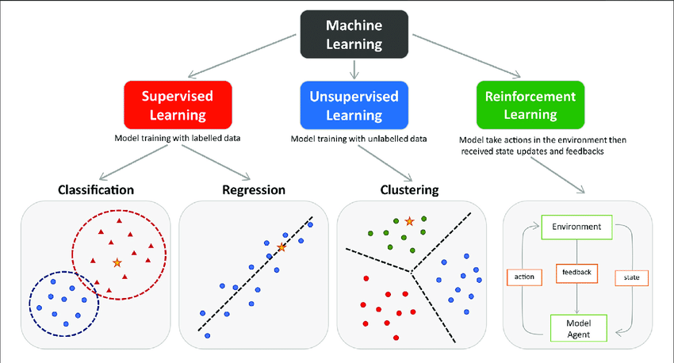
Machine Learning types
Package, APIs, Data Set and Models

Slide 12
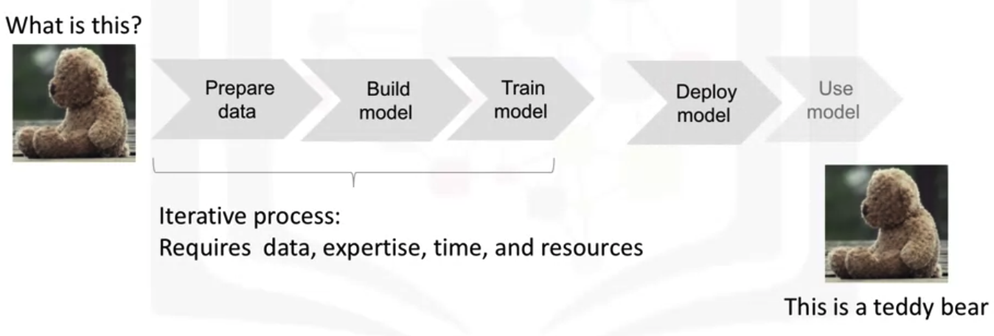
Machine learning
Using models to solve a problem
Package, APIs, Data Set and Models

Slide 13
Summary
Explain the function of an API and list some common API-related terms.
Discuss the characteristics of a dataset and the ways data can be structured.
Identify some of the libraries used in data science and the types of functionalities a library can provide.
Compare and contrast between machine learning, deep learning and their use cases.
Discuss the different classes of machine learning models.
Package, APIs, Data Set and Models

Slide 14
Q & A
Package, APIs, Data Set and Models

